Slide 1
Probiotic Supplementation Improves Cognitive Function and Mood with Changes in Gut Microbiota in Community-Dwelling Older Adults
Journal Club Article --- Emily Rose, dietetic intern
Keith & Associates Distance Dietetic Internship

Slide 2
Agenda
01 Introduction
02 Research question, population & Study Design
03 Independent & Dependent Variables
04 Methods, Results & Conclusion
05 Group Questions
06 Closing

Slide 3
Introduction
Notes:
Common threats to well-being in old age are neurodegenerative disorders and psychological distress.
It is important to look for ways to prevent/delay age-associated decline in brain function in the general older population.

Slide 4
Research Question: Does probiotic consumption have beneficial effects on intestinal health and contribute to improved cognitive and mental impairment in older adults? Population: Community-Dwelling Older Adults Study Design: Randomized Control Trial – Double-Blind, Placebo-Controlled, Multicenter Trial
Notes:
Population: Participants were recruited from communities in Seoul and Seongnam in the Republic of Korea. Over age 65
Invitation to Onsite screening
Assessed physical and cognitive function status
Used ADL, instrumental ADL & Mini-Mental State Examination by experienced research staff.
Study Design: Research showed probiotics affect intestinal microbial dynamics and homeostasis and influence the physiology of the intestine and distal organs including the brain! HOWEVER –most of the evidence comes from animal experiments. Thus, it is important to assess whether such findings can be translated into humans.

Slide 5
Independent & Dependent Variables
Notes:
Independent Variable – probiotic supplement
Dependent Variable –Cognitive Function, Mood & changes in the Gut Microbiota

Slide 6
Methods
Notes:
Refrain from dietary supplements
Randomly assigned – placebo or probiotic group
Consumed product BID for 12 weeks
Visit clinic q 4 weeks – for compliance, blood and fecal samples & neurological test at baseline, wk 4 & wk 12
Cannot change usual dietary habits and health-related behaviors
Record treatment intake & unsual events (medication use) or adverse events

Slide 7
Results
Decreased inflammation causing gut bacteria
Two types of bacteria shifted significantly
Significant improvements in flatulence and abdominal distention
Notes:
53 participants completed the study – no adverse events
Randomization was successful – no sig differences in those that completed the trial
Average age 71-71, ratio of male to female, socioeconomically differences & BMI not significantly different along with cognitive function and depression scores not significantly different at baseline
Significant changes in the probiotic group. (listed)

Slide 8
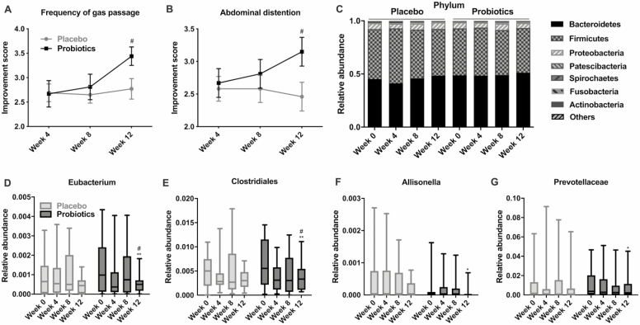
Notes:
These were found based on sequencing using 16s r-RNA sequencing technology from stool samples collected at baseline, 4th week, 8th week and 12th week
No sig changes at phylum level.
Sig changes at the Genus level in gut microbial composition in probiotic group and no changes in the control group
* Gradual change with most significant change seen at week 12.
Abundance of inflammation-causing gut bacteria was significantly decreased (p< .05)

Slide 9
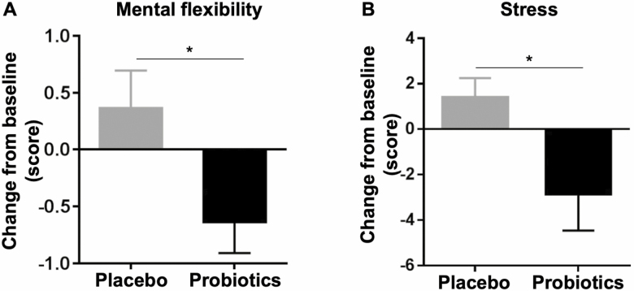
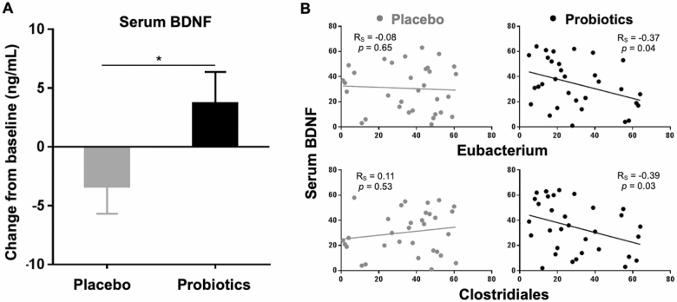
Significant increase in BDNF levels
Greater mental flexibility test and stress scores
Notes:
Start with mental flexibility & stress:
Cognitive test at baseline, week 4 & week 12. No sig difference between the two groups at week 4. Changes at week 12 from baseline were significantly different between the two groups. Mental flexibility
QOL scores – no change
Stress scores – increased in placebo (1.38 +/- 0.86) & dramatically decreased in the probiotic group (-2.85 +/- 1.16; p< .05)
Greater mental flexibility test and stress scores in probiotic group (p<.05)
This prompted researchers to determine BDNF in blood.
BDNF is a neurotrophic factor known to be crucial for learning, memory function, and stress. It is vital for synaptic formation, plasticity and neuroimmune responses.
Probiotics significantly increased BDNF levels (p <.05; 3.68 +/- 2.69)
Eubacterium and Clostridiales shifted significantly in the probiotic group – showed a significant negative correlation with serum BDNF level ONLY in the probiotic group
Rs=-0.37, Rs= -0.39 & p< .05)
This suggests that a probiotic supplementation supports reduction in the relative abundance of Eubacterium & Clostridiales thus increasing BDNP levels – suggesting improved brain functions.

Slide 10
Conclusion
Probiotics promote mental flexibility and alleviate stress in healthy older adults.
Notes:
Significant changes in the probiotic group.

Slide 11
Group Questions

Slide 12
What did you find the most interesting aspect of this paper?
This Photo by Unknown Author is licensed under CC BY-NC-ND
Notes:
Did anyone else notice that the probiotic capsules contained SOYBEAN OIL?
And the Placebo was soybean oil only! Soybean oil has been shown to increase inflammation in the body due to high omega-6 content! Inflammation in the brain and the body causes a decrease in ability.
Placebo, each capsule contained 500 mg soybean oil X 4 per day, 2000 mg soybean oil, that’s 2 grams of soybean oil. The AI form males is 17 and 12 for women

Slide 13
What did you find was the most important result of this paper?
Notes:
Total Sample size –53, 10% dropout rate
Probiotic type used – colony forming unit of Bifidobacterium bifidum and Bifidobacterium longum proven to be used to treat human disease.
–Anti-infection, anti-virus, anticancer, Anti-inflammation, promotes psychological health, reduces fat accumulation, facilitates host nutrition adsorption, promotes bone health, regulates host immune system, prevents Alzheimer’s in mice, restores vascular dysfunction
BDNF results – research shows that gut dysbiosis correlates with reduced expression of BDNF, altering cognitive function and triggering anxiety – supporting the role of BDNF in gut-brain axis *evidence from this study proves a shift in microbial community along with changes in the cognitive and mental scores.
Limitations – direct evidence of improvement in peripheral and cerebral inflammation by probiotic consumption is lacking. – crucial in linking gut-brain axis to this study????
Cognitive status – self-reported? Recall bias?
Study length – not long enough to monitor improvements – need for further studies
Probiotics have system-wide effects on gut-brain axis in healthy community-dwelling older adults by promoting cognitive and mental health and changing the gut microbial composition.
Provides evidence that probiotics have health-promoting properties as part of a healthy diet in the general population of independently living older adults.

Slide 14
How could this study be used in dietetics practice to improve patient care?
Notes:
Adults age 65+ should be put on a probiotic as a prophylactic measure to help reduce cognitive decline and mood variations.

Slide 15
Reference
Kim CS, Cha L, Sim M, Jung S, Chun WY, Baik HW, Shin DM. Probiotic Supplementation Improves Cognitive Function and Mood with Changes in Gut Microbiota in Community-Dwelling Older Adults: A Randomized, Double-Blind, Placebo-Controlled, Multicenter Trial. J Gerontol A Biol Sci Med Sci. 2021 Jan 1;76(1):32-40. doi: 10.1093/gerona/glaa090. PMID: 32300799; PMCID: PMC7861012.
Chen J, Chen X, Ho CL. Recent Development of Probiotic Bifidobacteria for Treating Human Diseases. Front Bioeng Biotechnol. 2021 Dec 22;9:770248. doi: 10.3389/fbioe.2021.770248. PMID: 35004640; PMCID: PMC8727868.

