Slide 1
Coffee Increases Post-Exercise Muscle Glycogen Recovery in Endurances Athletes: A Randomized Clinical Trial
By: Tyler Milliken

Slide 2
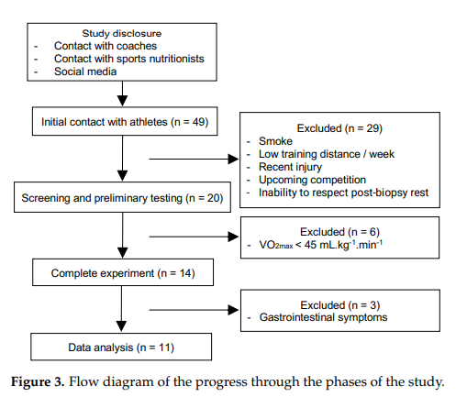
Study Design
Study Design: Randomized, double-blind, crossover clinical trial
N = 11, healthy endurance-trained adult men
Cycled at least 60 km per week (4h/wk)
1 year old experience in the sport
Regular coffee and milk consumers

Slide 3
Research Question
What is the effect of a coffee beverage after exhaustive exercise on muscle glycogen resynthesis, glycogen synthase activity and glycemic and insulinemic response?

Slide 4
Independent and Dependent Variable
Dependent: muscle glycogen recovery
Independent: beverage choices
Water with sugar
Coffee with milk and sugar
Milk with sugar
Decaf coffee with sugar
Coffee with sugar

Slide 5
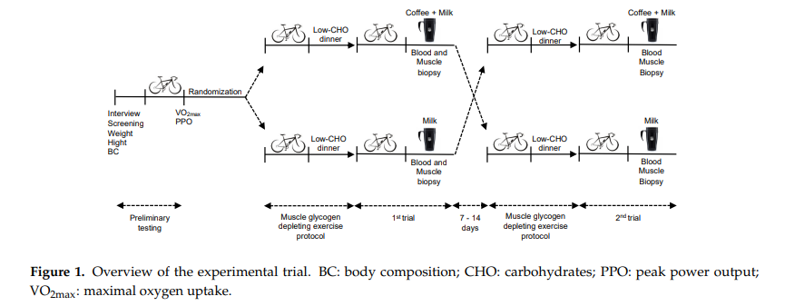
Methods

Slide 6
Methods
Started off with a preliminary incremental cardiopulmonary test
The last complete minute of maximal incremental cardiopulmonary exercise test was considered for obtaining the VO2max and the peak power output.
In the preparatory phase of each experimental session muscle glycogen levels were depleted by exhaustive cycle exercise and dietary intervention (low carbohydrate dinner)
On the morning of the experiment, fasting capillary glucose levels were measured and the leg in which the biopsy procedure would be performed was randomly defined
After 10 min of sitting rest, the second exercise protocol was initiated to guarantee maximum muscle glycogen depletion

Slide 7
Results
Muscle Glycogen Concentration
End of morning of experimental session no difference
After 4 hour recovery: consumption of coffee + milk was 153% greater
Glycogen Synthase Activity
End of recovery period, there was a decrease observed in both, but 149% greater when coffee + milk was consumed compared to milk. Note: this different was not statistically significant.
Serum Glucose and Insulin Levels
Levels did not differ
Analysis of glucose and insulin indicated that coffee consumption increased glycemic and insulinemic response

Slide 8
Discussion
The study showed that coffee increased post-exercise muscle glycogen resynthesis and the glycemic and insulinemic response during a 4 hour recovery period after an exhaustive cycling exercise session
The hypothesis was consistent
There is a large variability in muscle glycogen content reported by different studies due to the level of athletes’ training, type, frequency and type of supplements administration, and the total recovery period
Glycogen depletion protocol usually employed in studies with athletes does not correspond to real life training, since high intensity exercise training while fasting does not improve performance

Slide 9
Limitations and Advantages
Limitations:
Smaller sample size
Blinding was hard to do since coffee with milk and milk have different flavors
Advantages:
First study of its kind
Beverage recipes prepared in the trial was the possibility to control the carbohydrate content by either increasing or reducing the amount of sugar, according to the athlete's need.

Slide 10
Conclusion
The consumption of coffee with the sweetened milk improved muscle glycogen resynthesis better compared to just sweetened milk
The addition of coffee to a post-exercise beverage with adequate amounts of carbohydrates is an effective strategy to improve muscle glycogen recovery for those cycling athletes with a short-time recovery

Slide 11
Group Discussion and Questions
#1 Was there anything that stood out to you from this study?
#2 What do you think are the potential gaps or weaknesses of the study? Any strengths?
#3 Does this study make you want to consume coffee after exercising?

Slide 12
Works Cited
Loureiro LMR, Dos Santos Neto E, Molina GE, et al. Coffee Increases Post-Exercise Muscle Glycogen Recovery in Endurance Athletes: A Randomized Clinical Trial. Nutrients. 2021;13(10):3335. Published 2021 Sep 23. doi:10.3390/nu13103335

