Slide 1
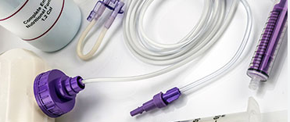
Controlled enteral nutrition in critical care patients – A randomized clinical trial of a novel management system
Patti Mills
Kagan I, Hellerman-Itzhaki M, Bendavid I, et al.. Controlled enteral nutrition in critical care patients – A randomized clinical trial of a novel management system. Clinical Nutrition. 2023;42(9):1602-1609. doi:10.1016/j.clnu.2023.06.018

Slide 2
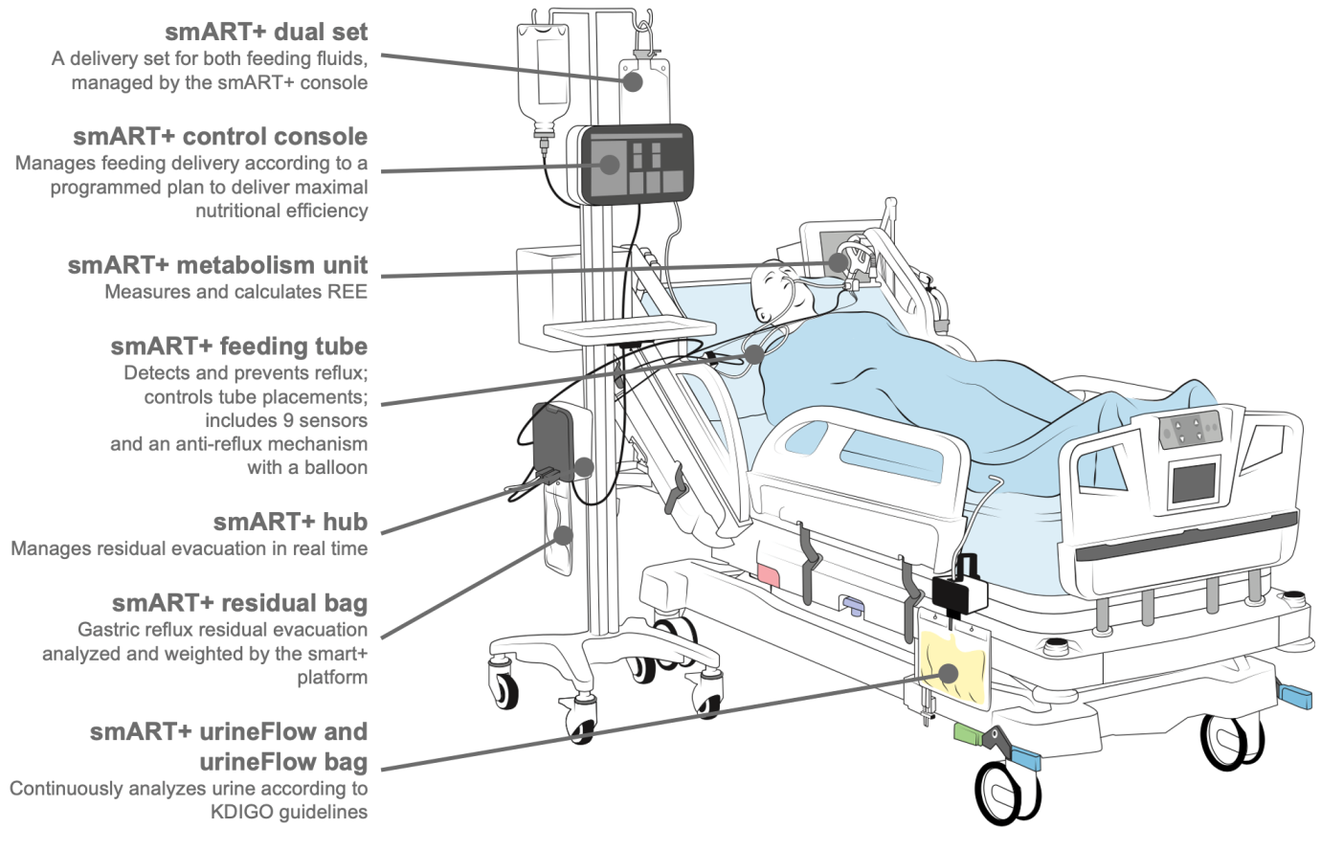
smart+ Platform
Supplemental Figure 1. Overview of the smART+ system
KDIGO, Kidney Disease Improving Global Outcomes (https://kdigo.org)
Notes:
Comprises control unit that runs the nutritional management software directed via a dual-port delivery feeding pump. Includes disposable treatment kits that include smart NGT with impedence sensors for assisting tube localization & detect tube movement, reflux episodes. Has a VCO2 module for REE, residual bag to gastric content from reflux, feeding delivery sets, and a urine bag
Detects reflux & can pause feeding, or inflate an esophageal balloon & reduce gastric pressure → prevents aspiration

Slide 3
Research Question
Does smART+ deliver targeted nutrition and improve ICU outcomes compared to standard-of-care in critically ill patients?
Standard-of-care is ESPEN-based guidelines

Slide 4
methods
Patients
Procedure
Outcomes
n=100 (n=50 per group) mechanically ventilated (planned for > 48 hrs); men and women
Average age 59.4 +17.5 yrs) (smART+) and 62.1 + 16 yrs (control) (NSD)
Started or about to start naso-orogastric enteral nutrition
Randomized (1:1) to ESPEN (control) or smART group via block randomization.
Nutritional targets for both groups set according to ESPEN guidelines
Formulas included: Peptamen A/F, Jevity, Nephrocare, Glucerna
Up to 14 days
Independent variable: Average deviation from daily feeding target between Days 2-14
Dependent variable: Gastric residual volume (GRV), length of stay (LOS), length of ventilation (LOV)
AE’s
Notes:
Exclusion: death imminent, pregnant, abnormalities of feeding canal that could hinder NGT placement

Slide 5
Results
Independent variable
Dependent Variable
Other
Mean feeding deviation b/w days 2-14 was 10.5% for smART+ vs 34.3% for control (p<0.0001).
Days of feeding within 90-110% of target was 75% in smART+ vs 23.3% for control (p<0.0001).
Deviations from nutrition plan were rare in smART+ group (4.8% vs 29.1% in control)
GRV: not reported?
LOS: significantly reduced in smART+ vs control (p=0.036)
LOV: significantly reduced in smART+ vs control (p=0.065)
AE’s: 4 in control group, 1 in smART+; ICU mortality similar
Overfeeding only occurred in 1 patient in smART+ group, just 2.7% above target vs 13 patients in control group (by 33.7 + 17%).
Underfeeding in 47 patients in smART+ (by 10.6 +13.1%) vs 37 patients in control (by 34.5 +18.6%).

Slide 6
Conclusion
The robot-guided smART+ enteral feeding is capable of delivering nutrition with an average deviation of only 10.5% from targeted daily amount, compared to 34.3% on standard feeding protocols, and substantially reduced the LOS and LOV for ICU patients.

Slide 7
Discussion Questions
Based on this information, is the smART+ platform something you would recommend to the ICU dietitian/clinical manager?
How would you improve this study, or what would you suggest as a follow up study?
What did you find most interesting?

Slide 8
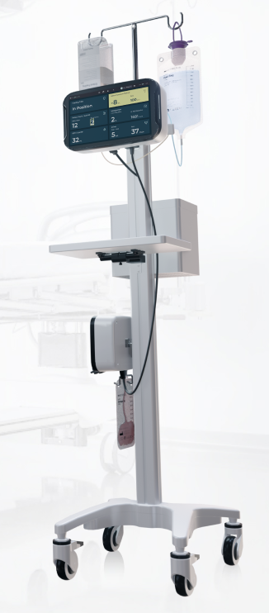
Thank you

