Slide 1
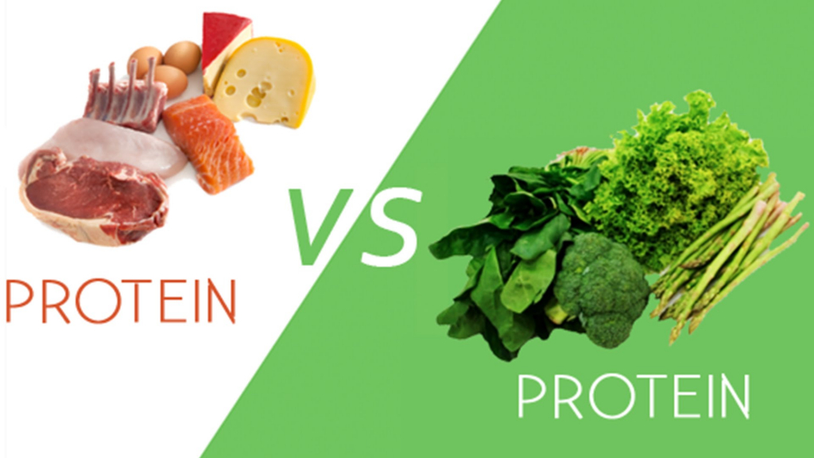
Animal Protein Versus Plant Protein in Lean Mass and Muscle Strength
Systemic Review/Meta Analysis of Randomized Controlled Studies

Slide 2
Population, Intervention, Comparator, Outcome, Setting (PICOS)
Adults aged 19 years and older
Animal based protein
Plant based protein
Differences in lean muscle mass / muscle strength
Randomized controlled trials

Slide 3
Protein Sources
Plant based protein:
Soy (isolate, concentrate, soy products)
Pea and rice protein
Animal based protein:
Whey (isolate, concentrate, hydrolysate)
Casein (casein plus whey mix)
Beef and Dairy

Slide 4
Measurements of Muscle Mass / Strength
Dual X-Ray Absorptiometry
Measures bone density
Air Displacement plethysmography
Measure body composition
1 Repetition Max Exercise
Max weight lifted for a single repetition
1 Rep Max Muscle/Strength
Bench Press and Squat
Grip Strength
Torque leg/knee ext/flexion

Slide 5
Results of Study
Both protein sources provided higher median value of lean mass
Animal protein provided a favorable effect on absolute lean body mass compared to plant protein, though no statistically significant.
However, animal protein did provide a statistically significant increase in percentage of lean body mass vs plant based
In adults aged <50 years there was an increase of 0.41kg and 0.50% of lean mass utilizing animal-based protein when compared to plant based. While no difference was noted with adults aged >50 years.
No statistical difference was seen based on muscle strength for both protein sources. However, adults aged <50 years did see a significant effect on peak torque leg extension.
Overall, animal protein might be deemed higher quality due containing essential amino acids improving anabolic effects and its digestibility.

Slide 6
Group Discussion and Questions
1. What do you think are potential gaps or weaknesses of this study?
2. How would you incorporate this knowledge into your field of study or professional setting?
3. Which protein source do you believe is more beneficial in assisting with wound healing?
4. Do you think plant protein without essential amino acid supplementation is sustainable for the human body?
Group Discussion
Potential Gap
Applying Info
Wound Healing

Slide 7
Works Cited
1. Lim MT, Pan BJ, Toh DWK, Sutanto CN, Kim JE. Animal protein
versus plant protein in supporting lean mass and Muscle Strength: A
systematic review and meta-analysis of randomized controlled trials.
Nutrients. February 18, 2021. Accessed June 12, 2023.
https://www.ncbi.nlm.nih.gov/pmc/articles/PMC7926405/.
2. Molai N. Animal protein vs plant protein: Fortress Nutrition LLC:
Packaging Manufacturing. Fortress Nutrition. August 31, 2018.
Accessed June 12, 2023. https://www.fortressllc.com/animal-protein-
vs-plant-protein/.

